Slide 1

Spotify

Slide 2

Spotify
Atrocities

Slide 3
Spotify
The Villain Plan
Atrocities

Slide 4

Atrocities
The Villain Plan
Spotify

Slide 5
The Villain Plan

Slide 6
LIMITATIONS
The Villain Plan
WHY?
Spotify
introduced more Restrictions for free users in India

Slide 7
LIMITATIONS
Free Users Can’t play songs in specific order, repeat songs. Or Tap back to previous songs
Smart Shuffle is the default listening mode for free users
Free users can’t rewind or skip songs.
Spotify
introduced more Restrictions for free users in India
WHY
WHY?

Slide 8
It is revealed that Spotify in 2022 suffered a net loss of 430 million Euros
The data of the free users are incredibly very in number, which can be very hard to maintain.
Especially India where, the free members users are very high so, Introducing this change will be a encourage more paid subscribers
Free Users Can’t play songs in specific order, repeat songs. Or Tap back to previous songs
Smart Shuffle is the default listening mode for free users
Free users can’t rewind or skip songs.
LIMITATIONS
WHY?

Slide 9
It is revealed that Spotify in 2022 suffered a net loss of 430 million Euros
The data of the free users are incredibly very in number, which can be very hard to maintain.
Especially India where, the free members users are very high so, Introducing this change will be a encourage more paid subscribers
Free Users Can’t play songs in specific order, repeat songs. Or Tap back to previous songs
Smart Shuffle is the default listening mode for free users
Free users can’t rewind or skip songs.
LIMITATIONS
WHY?

Slide 10
It is revealed that Spotify in 2022 suffered a net loss of 430 million Euros
The data of the free users are incredibly very in number, which can be very hard to maintain.
Especially India where, the free members users are very high so, Introducing this change will be a encourage more paid subscribers
LIMITATIONS
WHY?

Slide 11
Why This is a Bad Move From Spotify?
Majority of the People will not switch to Premium even though Spotify leaves the free users with no choice but to buy Premium
Majority of them will switch to the alternatives like YouTube Music
Most of the People will illegally Download songs. And switch to Local playing
LIMITATIONS
WHY?

Slide 12

“
Why This is a Bad Move From Spotify?
Whatsapp, Facebook La Ivlo, Masam Ketunah Dha Ad Varadhu Apdi Nu Sonna Evlo Peru Povingha?
- Meta Monkeys
Majority of the People will not switch to Premium even though Spotify leaves the free users with no choice but to buy Premium
Majority of them will switch to the alternatives like YouTube Music
Most of the People will illegally Download songs. And switch to Local playing

Slide 13
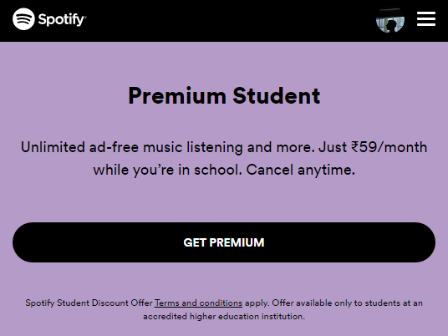
“
Whatsapp, Facebook La Ivlo, Masam Ketunah Dha Ad Varadhu Apdi Nu Sonna Evlo Peru Povingha?
- Meta Monkeys
Spotify has University Offers to us students for ₹59/month. For verification, SheerID asks for our ID card

Slide 14

“
Spotify has University Offers to us students for ₹59/month. For verification, SheerID asks for our ID card
Whatsapp, Facebook La Ivlo, Masam Ketunah Dha Ad Varadhu Apdi Nu Sonna Evlo Peru Povingha?
- Meta Monkeys
Thank You!
This is Ashik D.
AI & DS

Slide 15
Thank You!
This is Ashik D.
AI & DS

